Slide 1

Group 6
Team work 1
A10523006 Maggie
A10523049 Peggy
B10423003 Kurumi
B10423029 Bean
B10523020 Kendy
B10523030 Jerry
B10523053 Lynn
M10723001 Joe
The Library Management System

Slide 2
- Content
Introduction
Use Case Diagram
Use Case Description
Activity Diagram
Sequence Diagram
Class Diagram
Behavior State Machine

Slide 3
Introduction
Maggie

Slide 4





-Introduction x Maggie
Member
Book
search Paper book.
borrow paper book & read E-book.
Search & Borrow
Guest
search Paper book.
E-book
Search & Read
Librarian
returning books
managing the collection of the library.
Notes:
這是我們的圖書館有分為
紙本書 能夠供會員館外借閱
電子書 能夠供會員線上閱讀
然後我們一共有三種身分
Guest
member
librarian
Guest只能夠搜尋紙本書籍
Member 除了能夠搜尋 還能夠借閱紙本書跟閱讀電子書
Librarian可以管理館藏資訊 也負責歸還書處理

Slide 5
Use Case Diagram
Kurumi

Slide 6
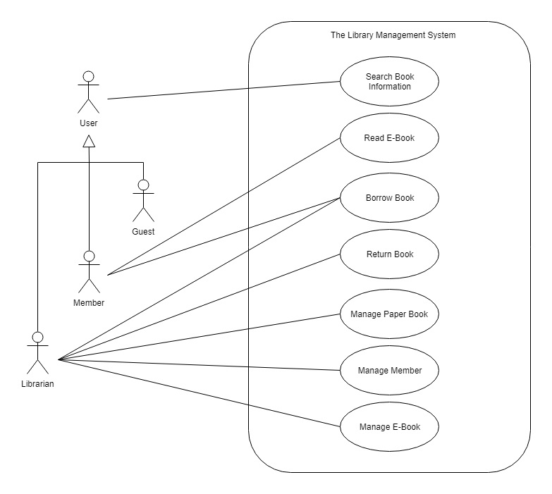
-Use Case Diagram x Kurumi

Slide 7
Use Case Description
Peggy

Slide 8
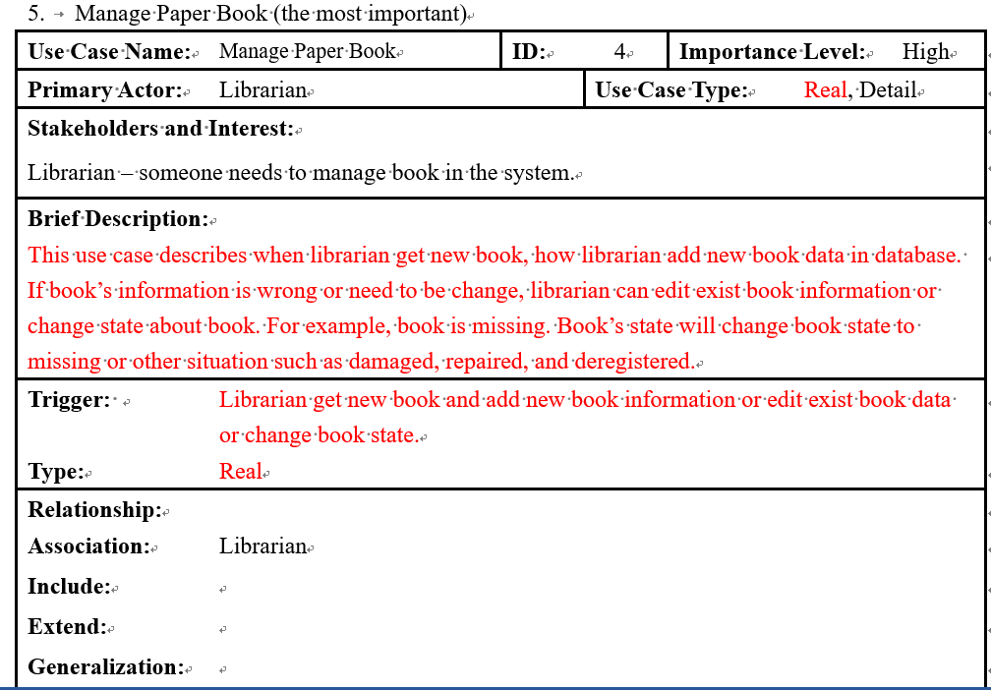
-Use Case Description x Peggy -1

Slide 9
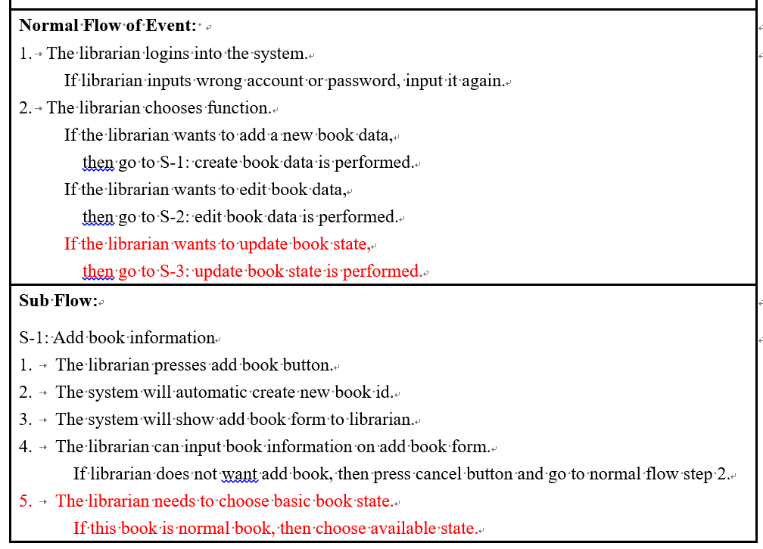
-Use Case Description x Peggy -2

Slide 10
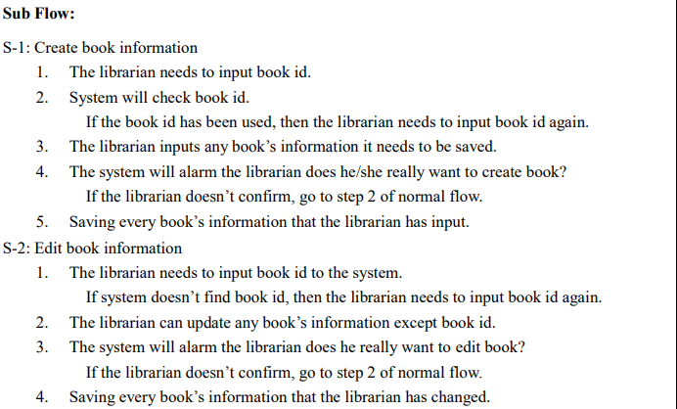
-Use Case Description x Peggy -3

Slide 11
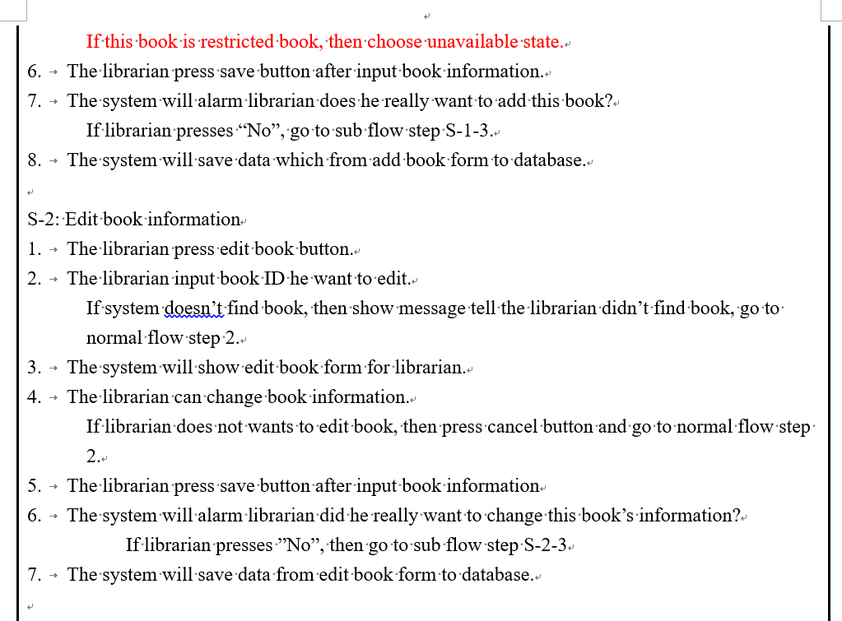
-Use Case Description x Peggy -4

Slide 12
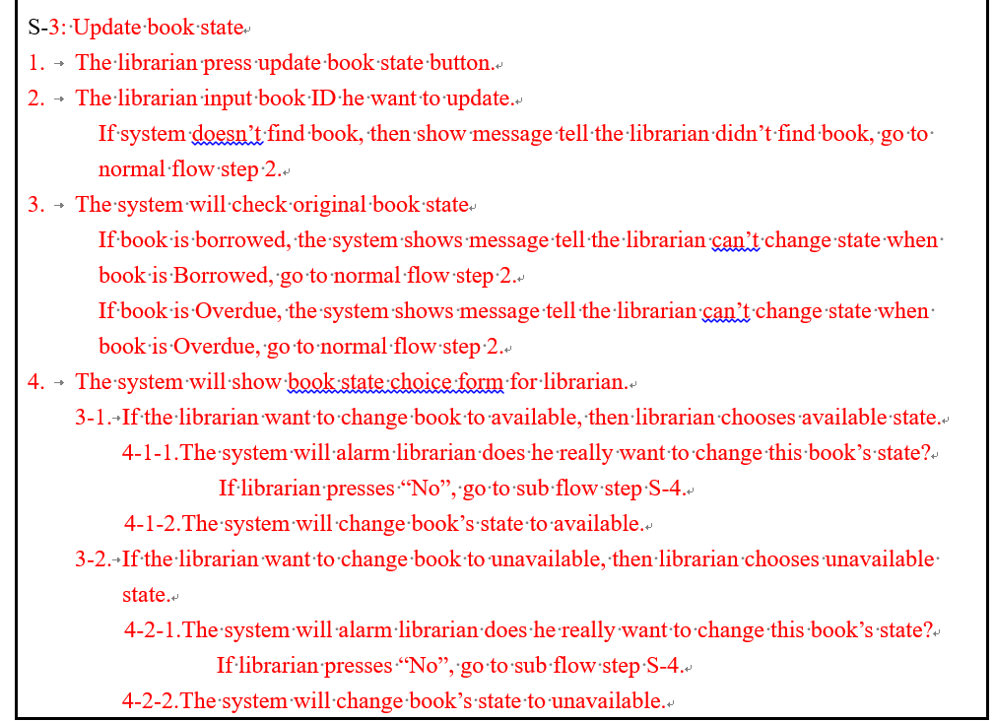
-Use Case Description x Peggy -4

Slide 13
Activity Diagram
Joe

Slide 14

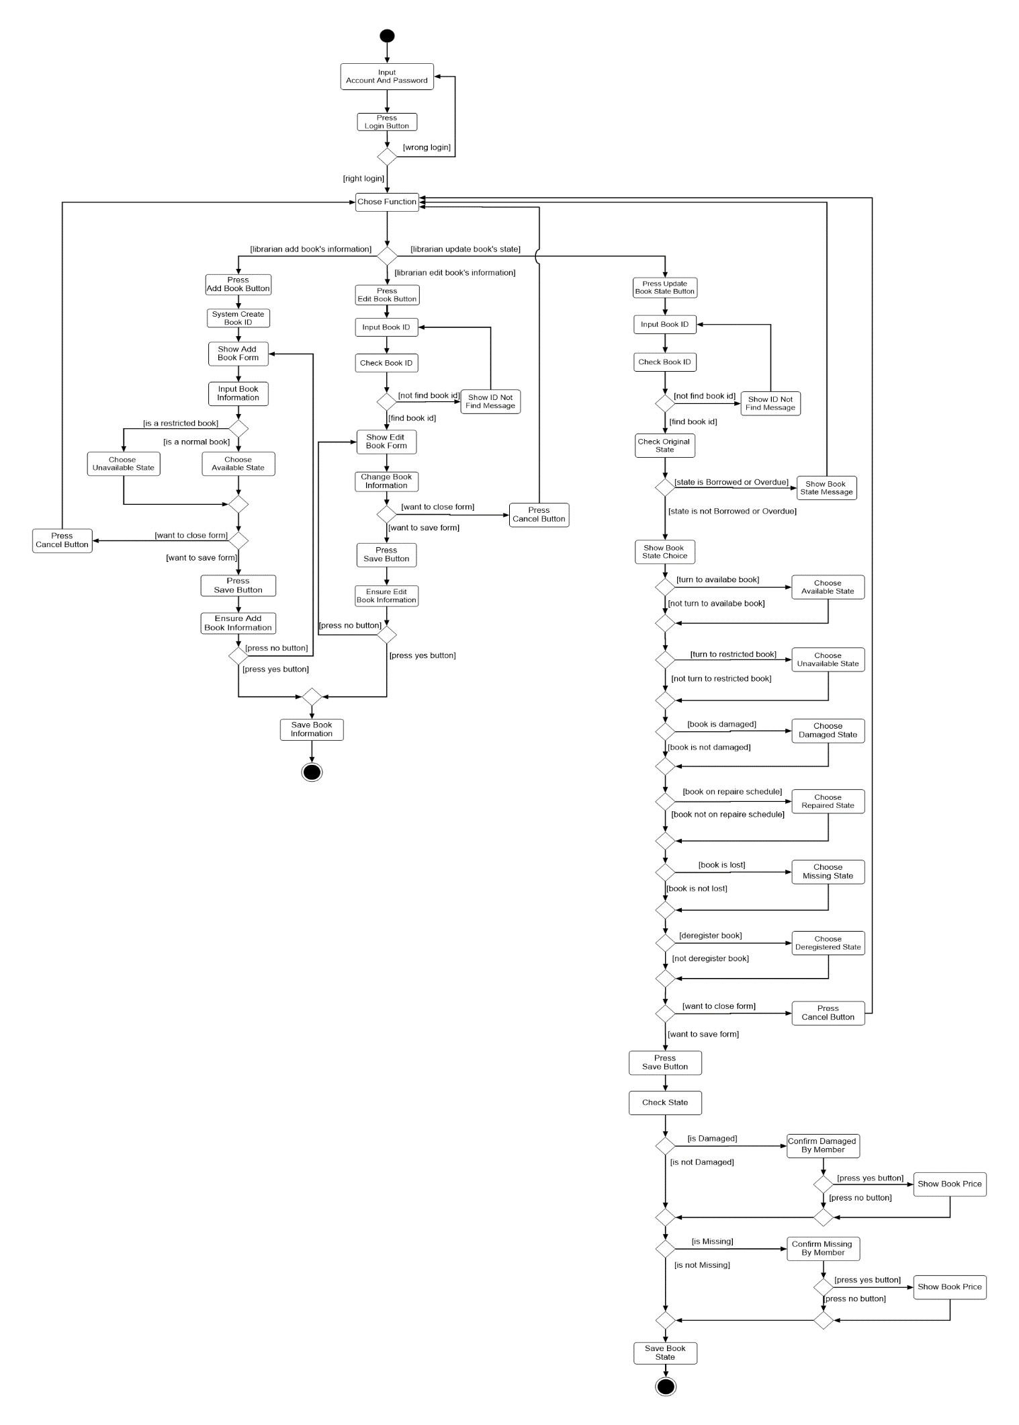
-Activity Diagram x Joe

Slide 15
Sequence Diagram
Lynn

Slide 16
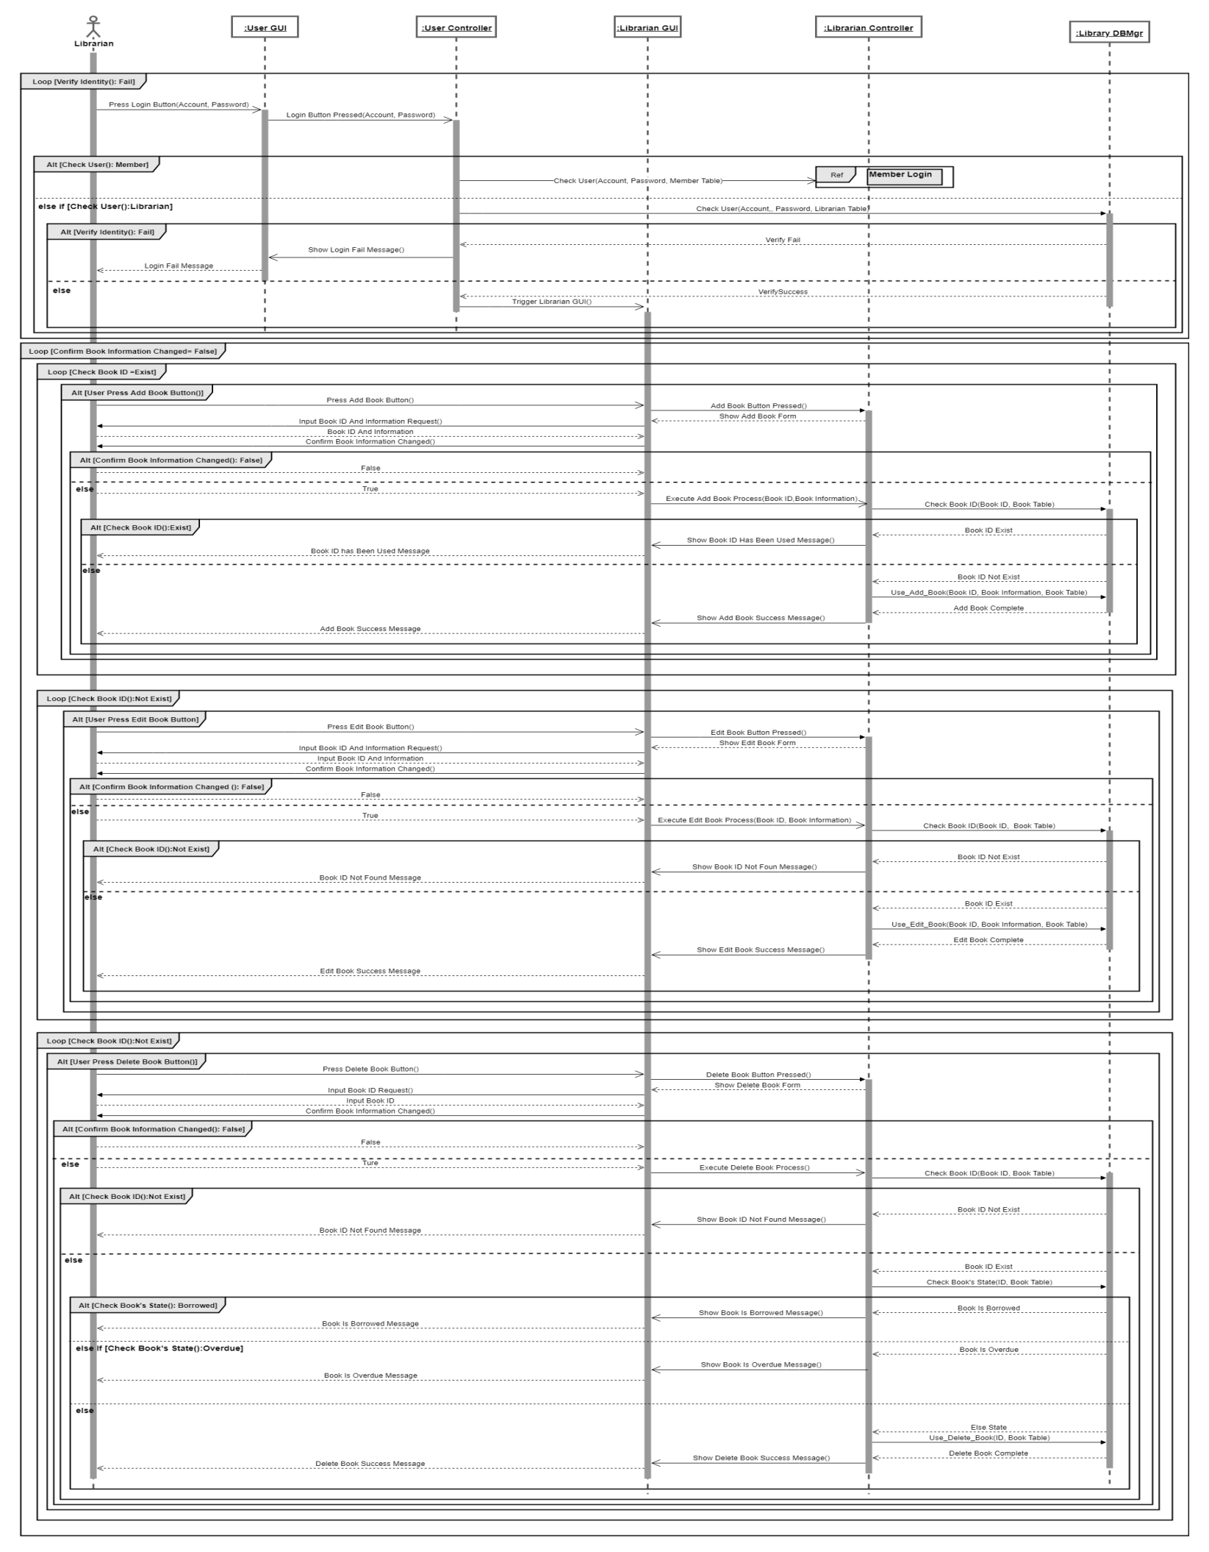
-Sequence Diagram x Lynn - old

Slide 17
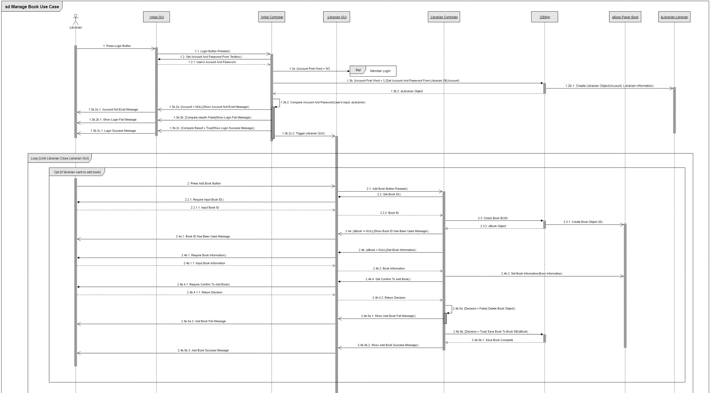
-Sequence Diagram x Lynn – 1

Slide 18
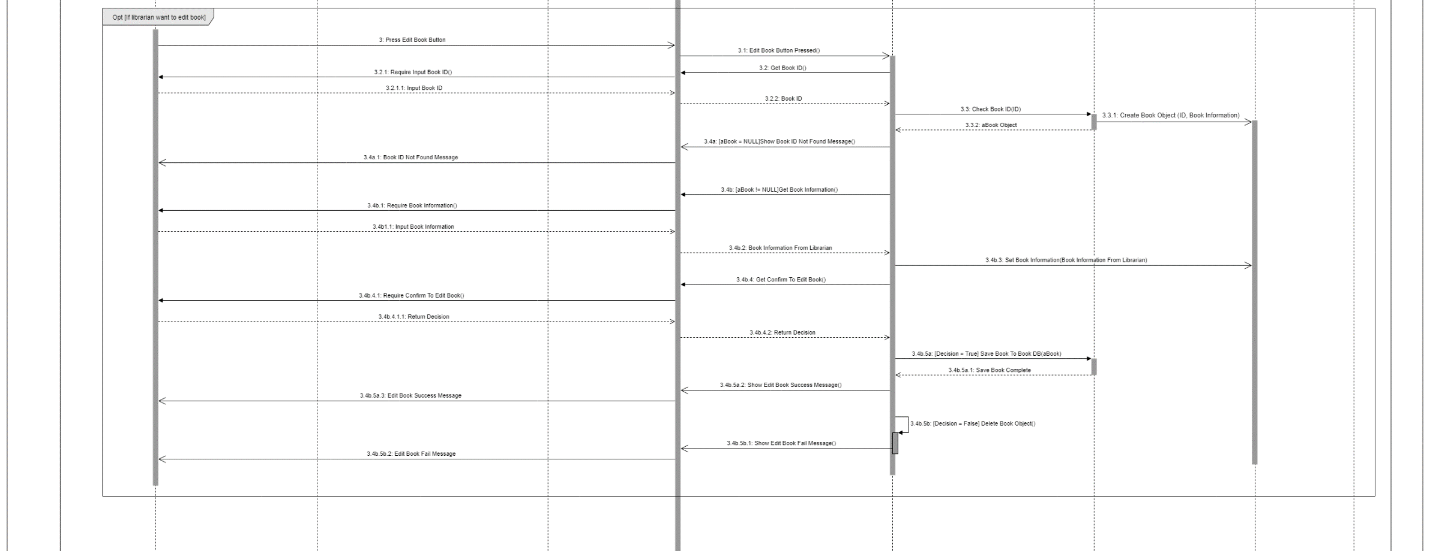
-Sequence Diagram x Lynn - 2

Slide 19
-Sequence Diagram x Lynn -3

Slide 20
Class Diagram
Kendy

Slide 21
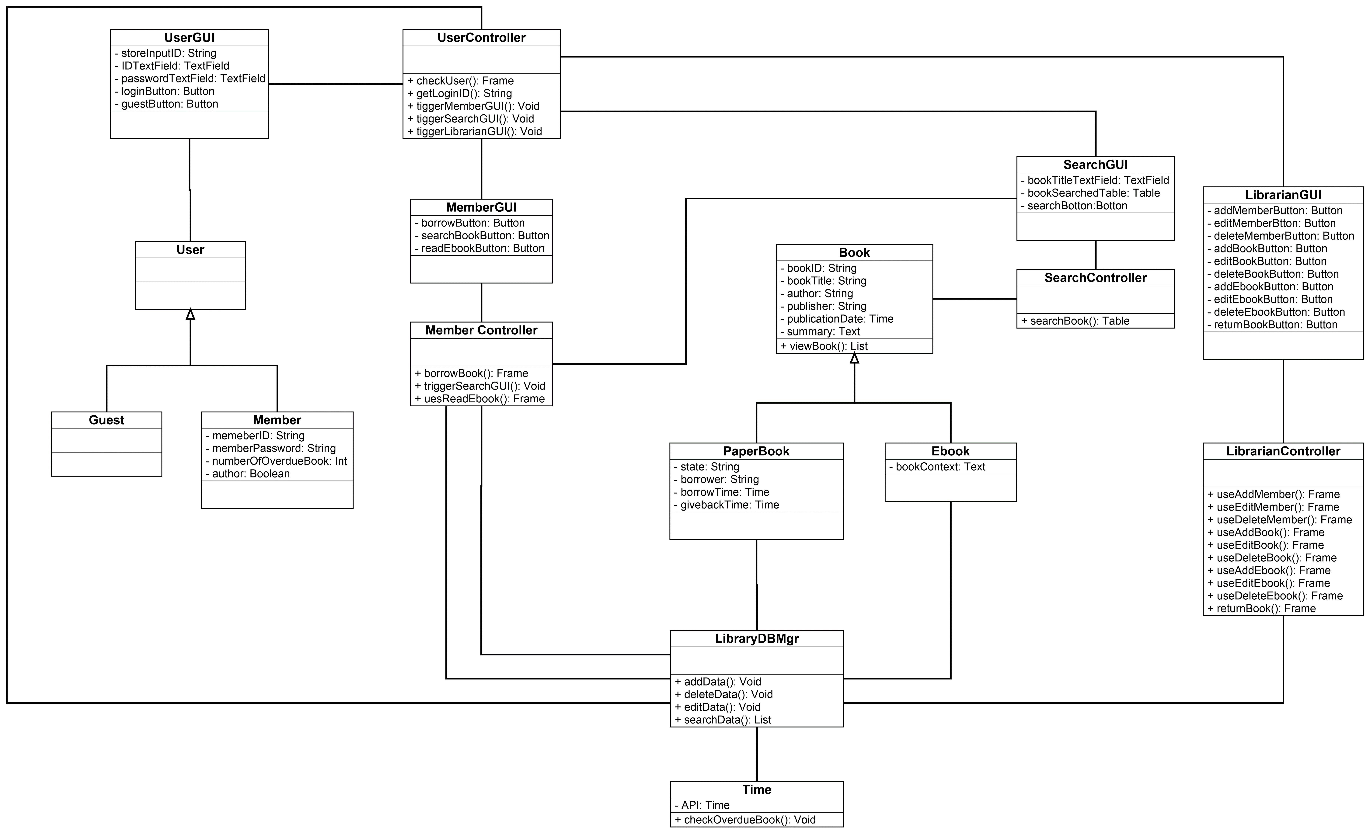
-Class Diagram x Kendy - old

Slide 22
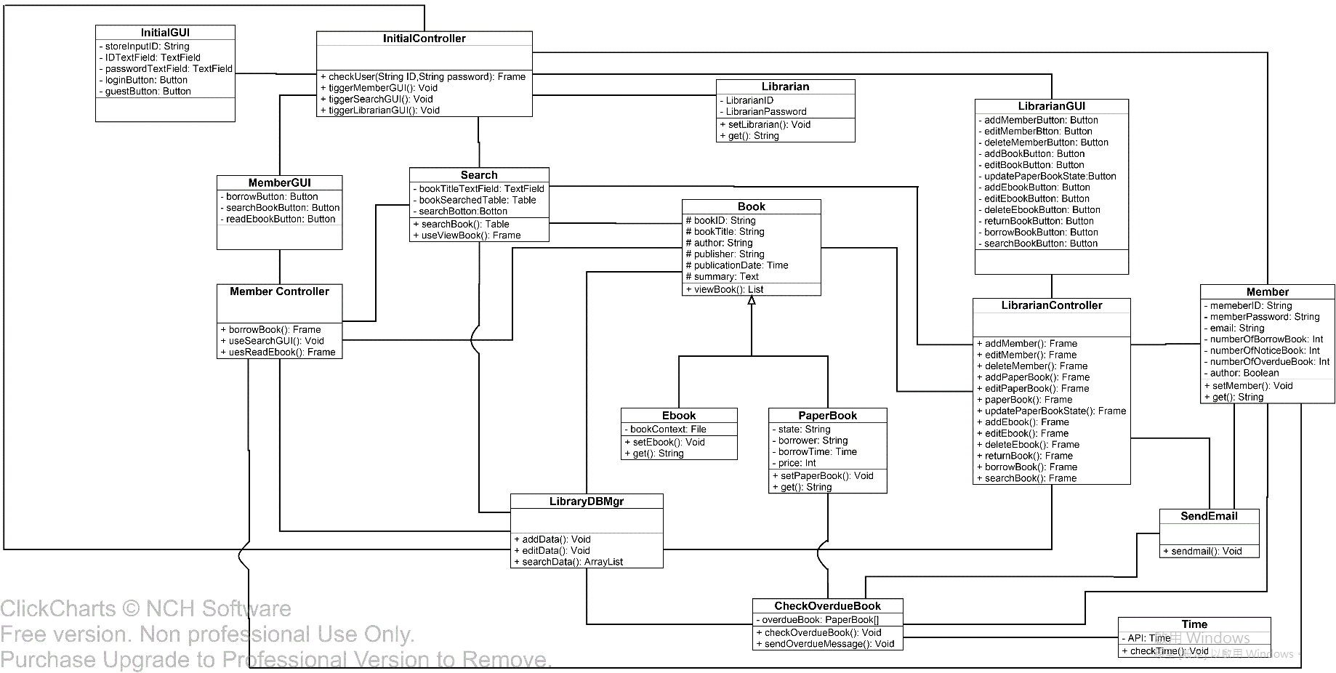
-Class Diagram x Kendy - new

Slide 23
Behavior State Machine
Jerry

Slide 24
-Behavior State Machine x Jerry

Slide 25
Thank you!
Group 6

